Slide 1
Counseling Services
Welcome
to OSUIT

Slide 2
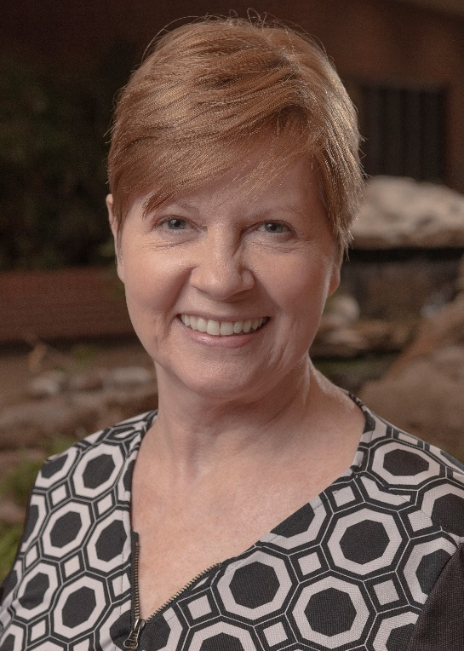
Counseling Services
Counselor
Kathy Avery, M.A.

Slide 3
MISSION
The mission of Counseling Services
is to support the
intellectual, emotional,
and personal
growth of OSUIT college students.

Slide 4
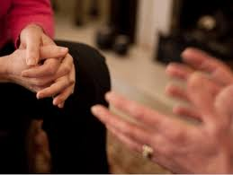
About OSUIT Counselors …
have at least a Master’s degree
focus on personal change
help cope with life transitions
can help you understand behavior

Slide 5
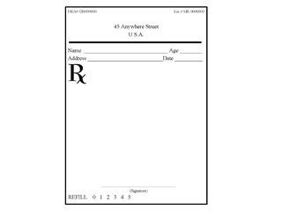
… about Counselors
OSUIT counselors can not:
prescribe medications
diagnose mental illness
perform long-term therapy
For serious mental health issues, referrals are made to community resources.

Slide 6
Some Common Reasons
Students Talk to Counselors:
relationship issues
adjusting to college
coping with stress
feelings of depression
juggling responsibilities
academic issues

Slide 7
Counseling is….
Free to OSUIT students
Confidential

Slide 8
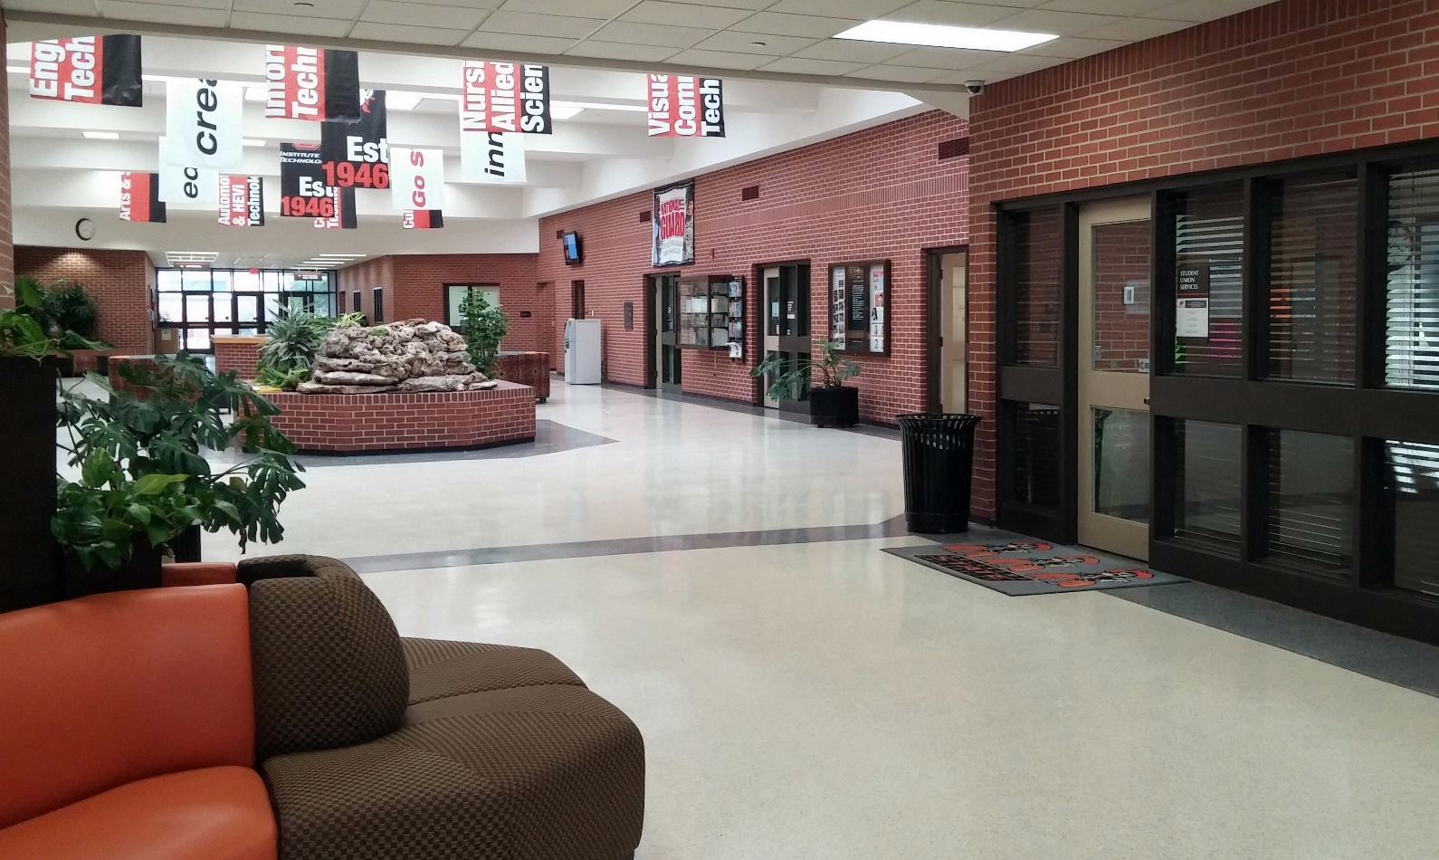
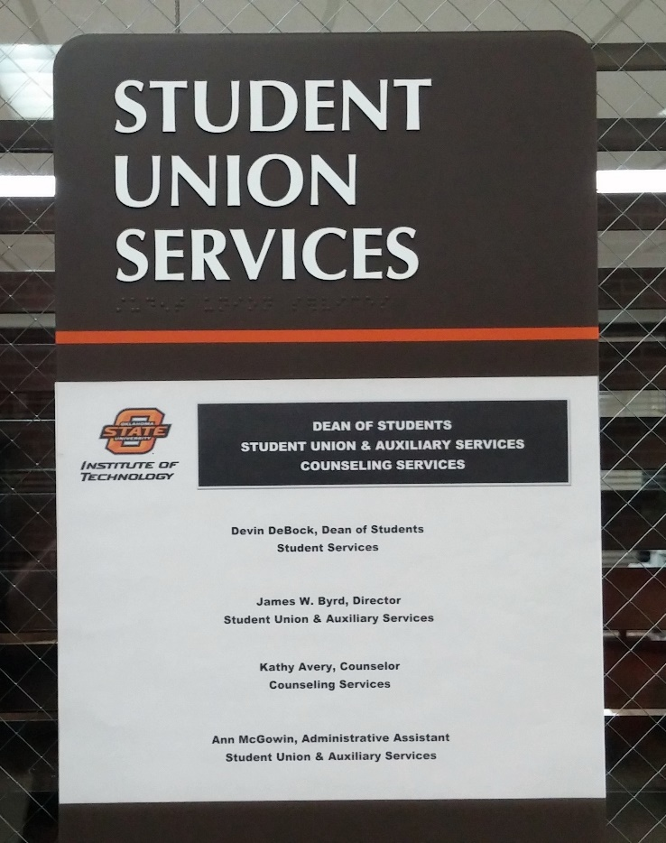
Location
Student Union Services
Room 142

Slide 9
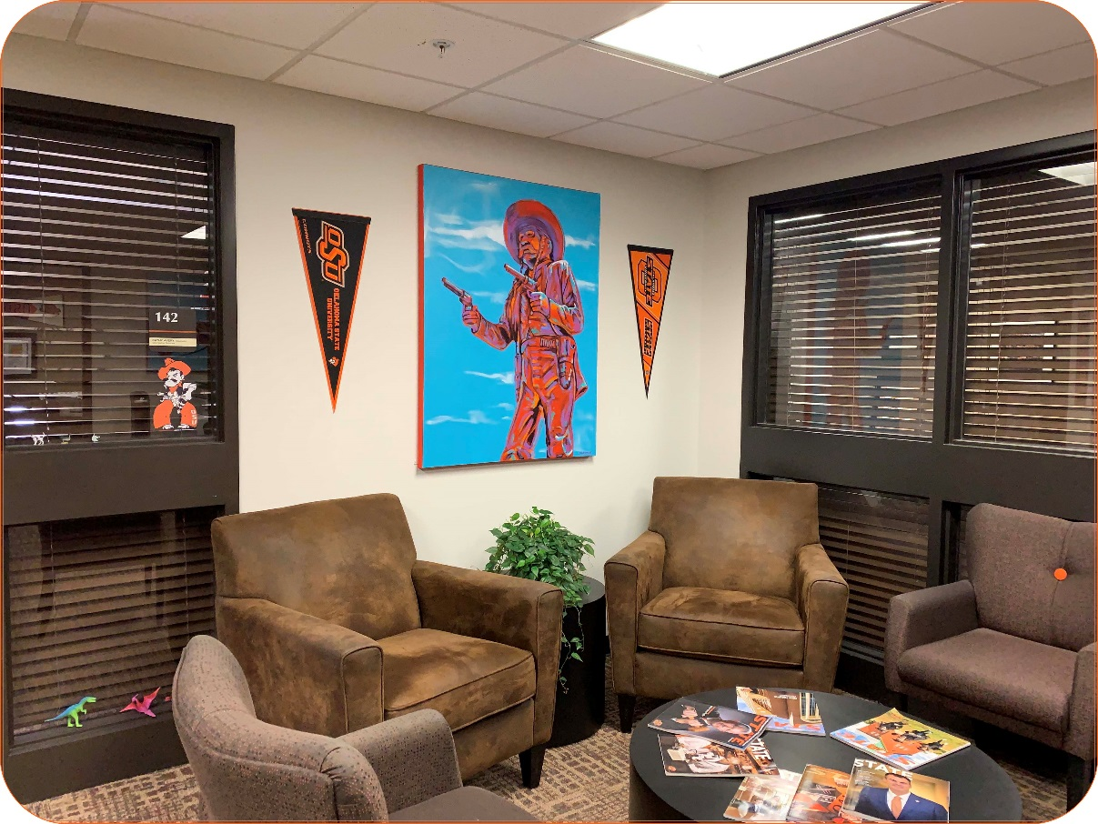
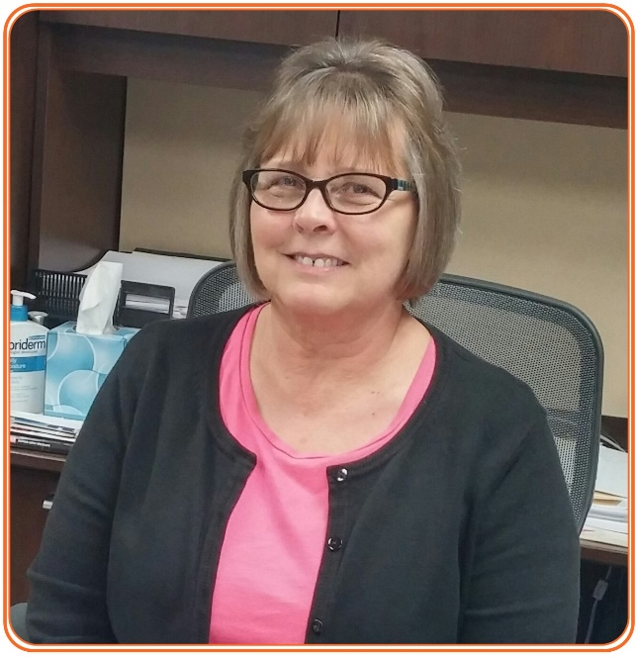
Welcome to Counseling Services
Ann McGowin

Slide 10
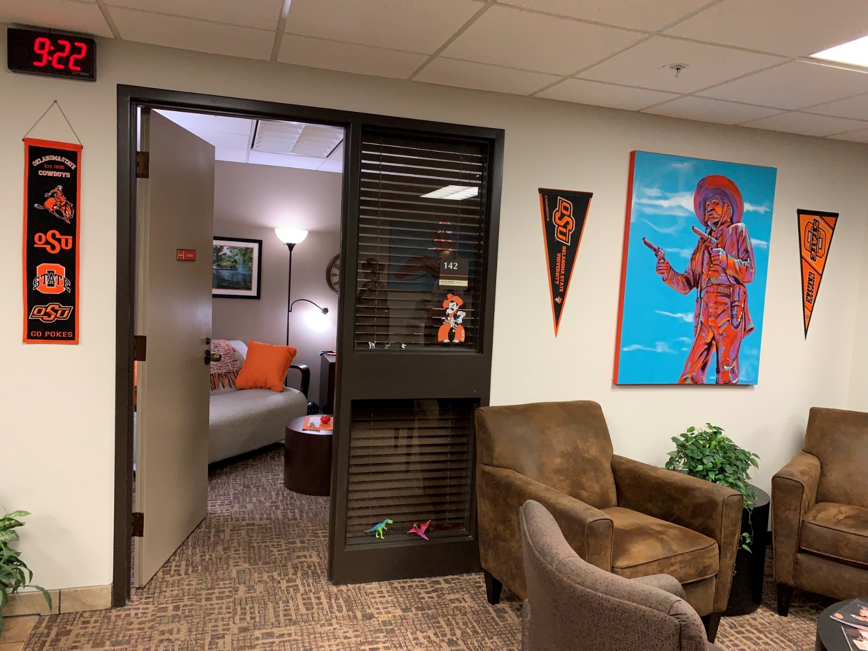

Slide 11
Hours: Monday – Friday 7:30 am – 4:30pm
Phone: 918-293-4988
Email: kathy.avery@okstate.edu

Slide 12
Web Page
www.osuit.edu/counseling
Revised 8/6/2019

Slide 13
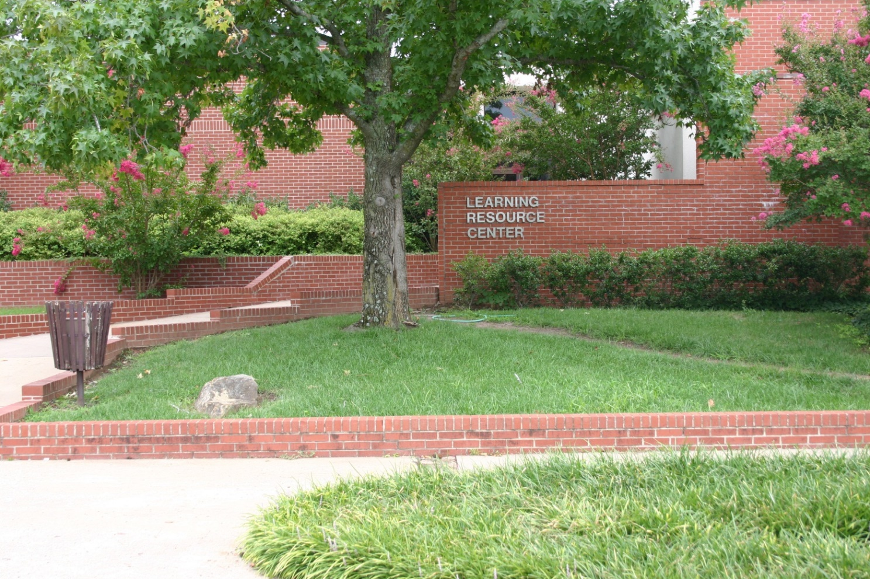
OSU Institute of Technology
Library
Notes:
The Library is located inside the Learning Resource Center and is sometimes referred to as the LRC
We are next to the Grady Clack Building

Slide 14
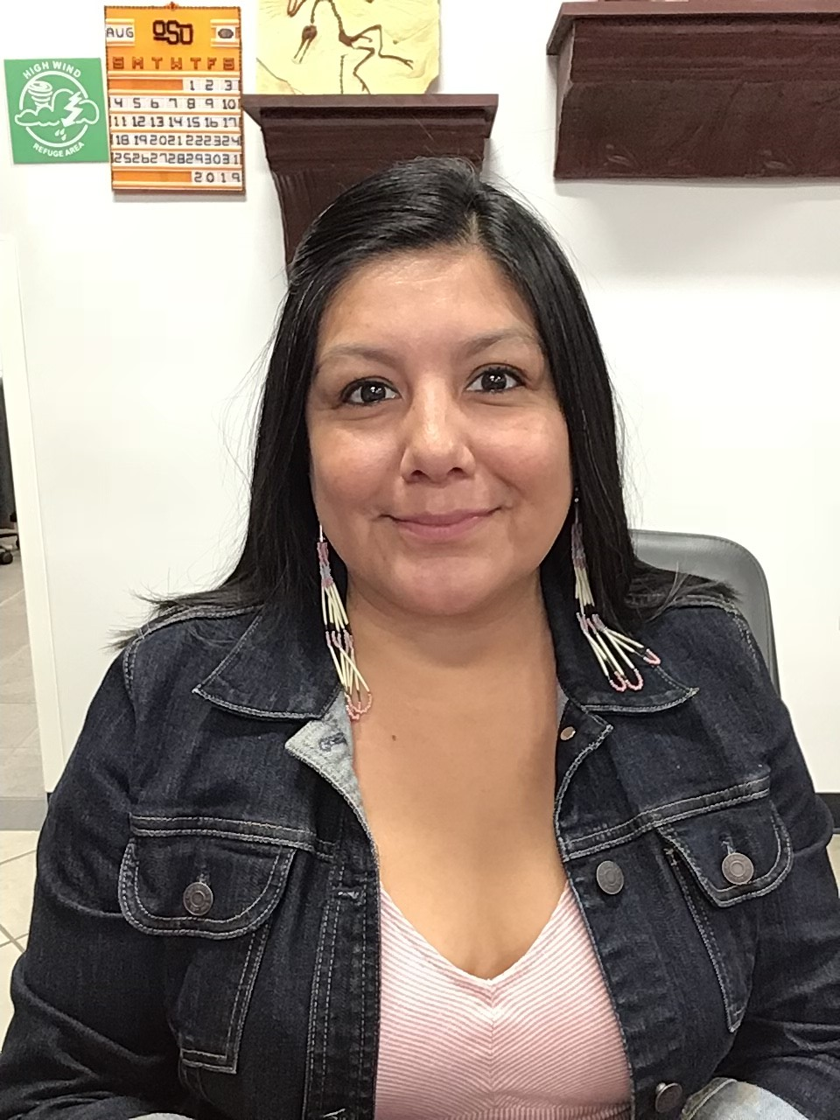
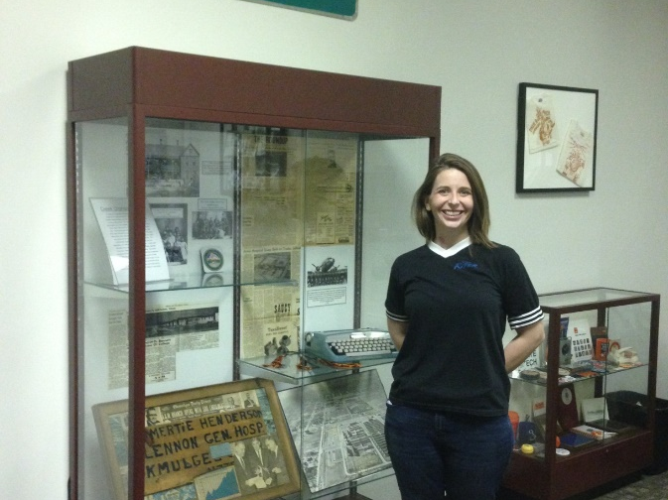
Denise Carter Library Technical Assistant
Library Staff
Kristin Pickett
Emerging Technologies & Instruction Librarian
Randy Chalakee
Library Assistant
Beth Kieffer
Distance Learning Librarian & Archivist

Slide 15
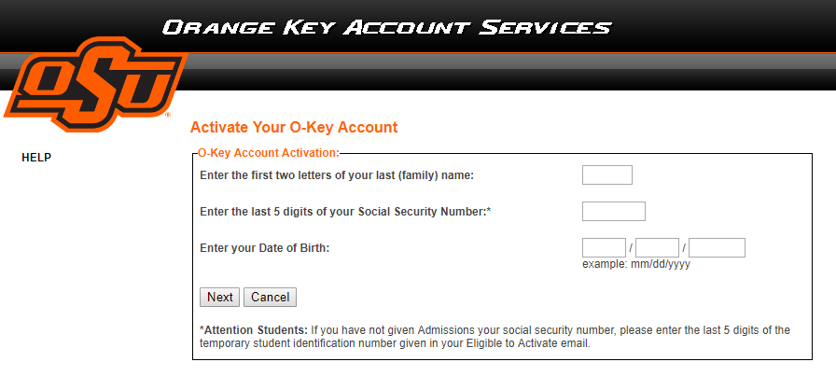
http://okey.okstate.edu

Slide 16
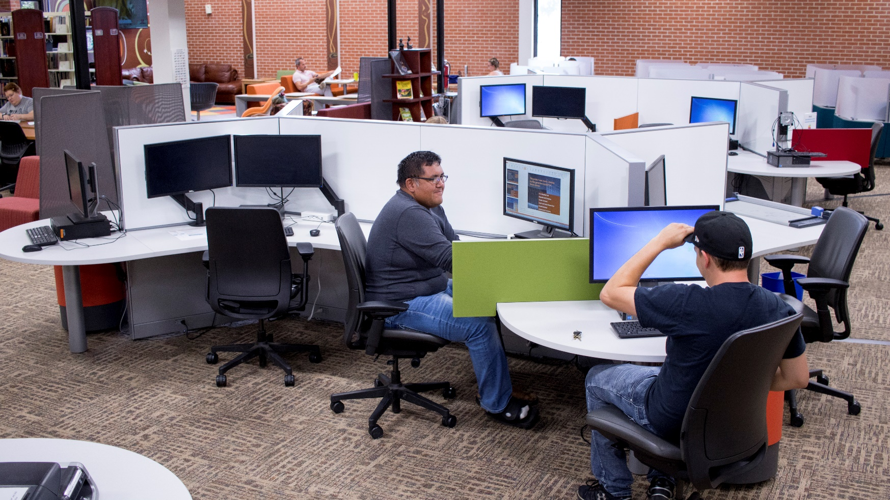
25 Computers
2 iMac’s
2 Touch Screens

Slide 17
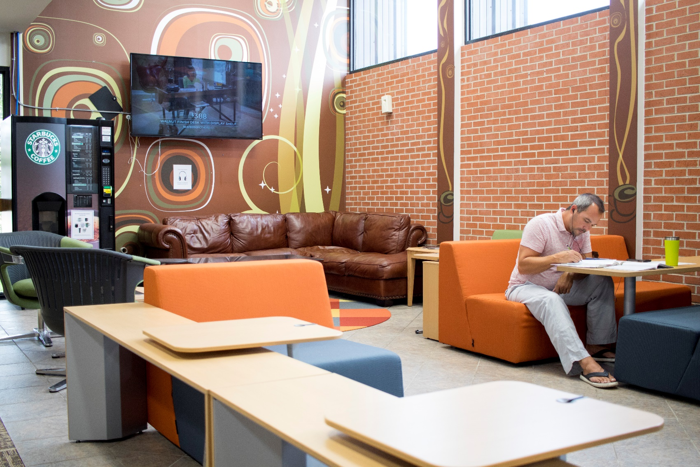
Starbucks Coffee! Food and Drink are Allowed in the Library

Slide 18
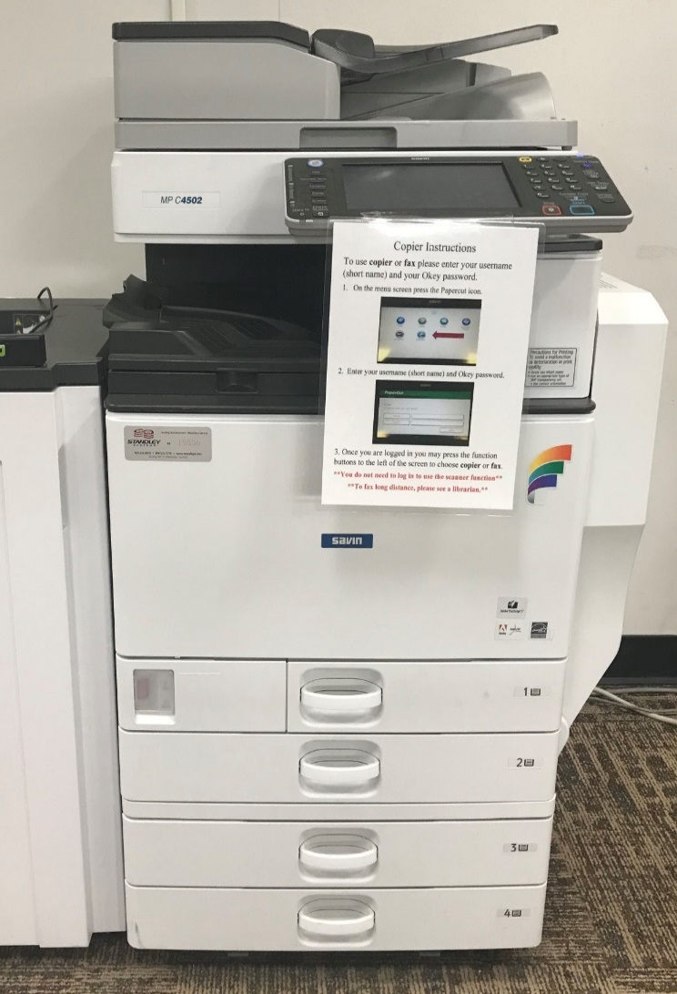
Library Services
Printer
Copier Scanner
Fax

Slide 19
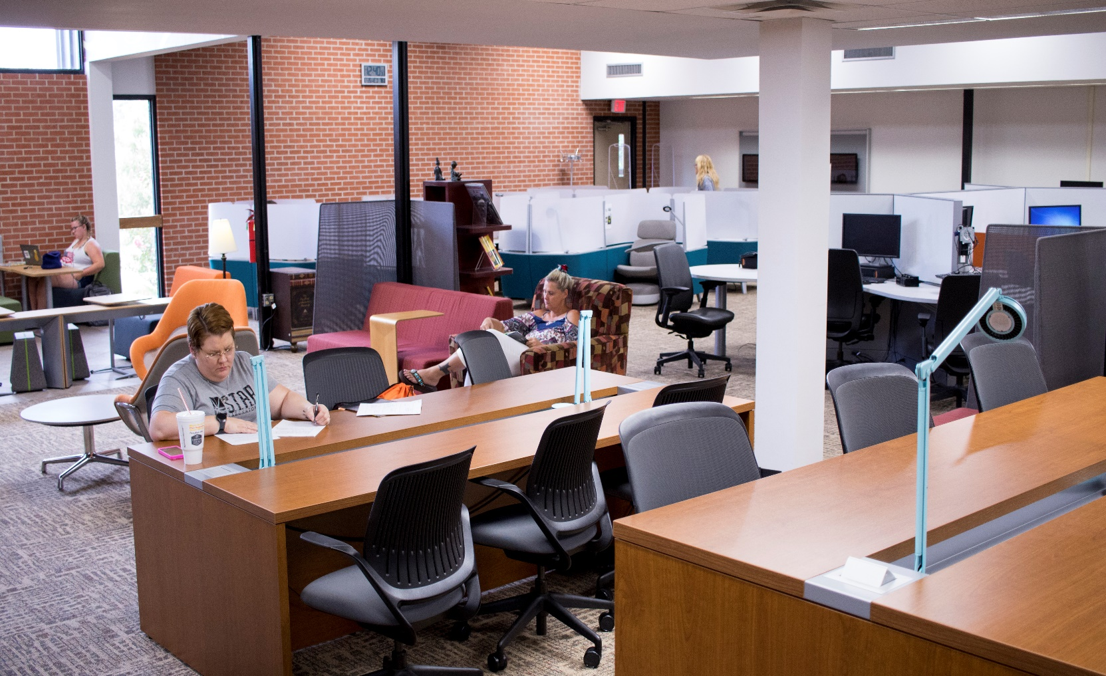
Study Spaces

Slide 20
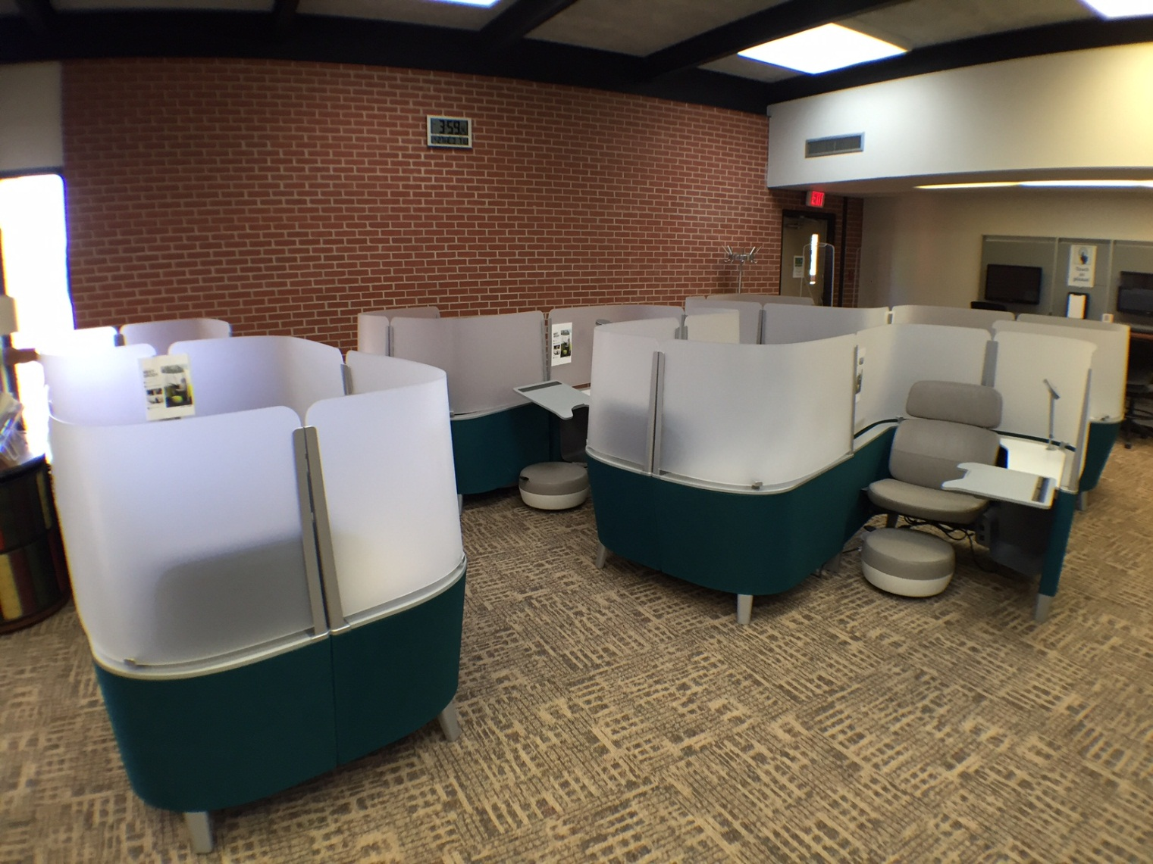
The Brody

Slide 21
Smaller Study Rooms 1 – 2 People

Slide 22
Mediascape Room
5 – 6 people

Slide 23
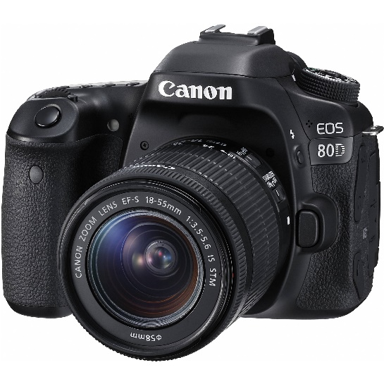
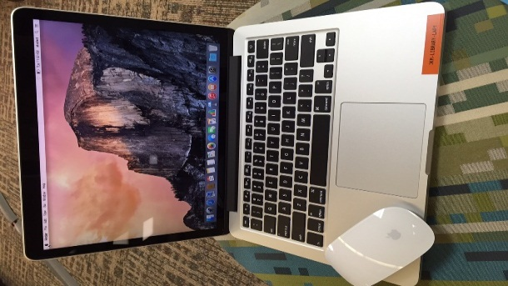
Tech To-Go Program
New and emerging technology
Prepare for use in career
Use for school work or leisure
“Try before you buy”
Technologies include:
Over 50 laptops and MacBooks
Cameras, Go Pros, projectors
Wearable Technology (Watches, VR head sets, etc.)
Program specific items (multimeters, battery testers, etc.)
30 Hotspots
3D Printers
Checkout periods vary. See the library website for full details:
osuit.edu/library

Slide 24
Hoopla Digital

Slide 25
Textbooks
Dozens of current textbooks
2 hour in library checkout

Slide 26
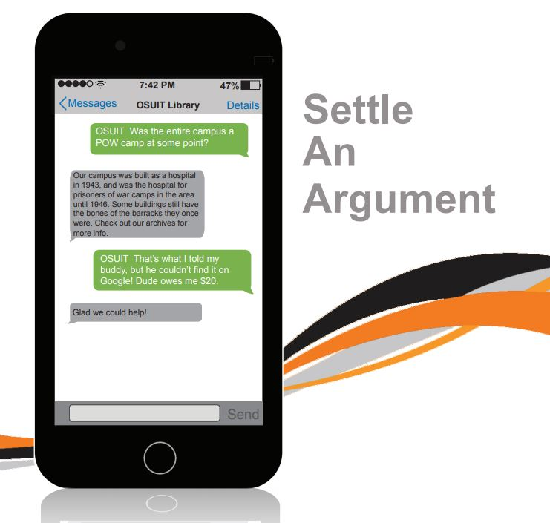

Slide 27
Library Hours
Monday – Thursday:
7:00a – 9:00p
Friday: 7:00a – 4:30p
Saturday: Closed
Sunday: 2:00p – 9:00p
918.293.5080
www.osuit.edu/library

