Slide 1
CCSSE 2015 Findings for OSU Institute of Technology

Slide 2
Presentation Overview
CCSSE Overview
Student Respondent Profile
CCSSE Benchmarks
Notes:
This presentation covers three areas: An Overview of CCSSE, a Profile of Student Respondents, and CCSSE Benchmarks

Slide 3
CCSSE Overview

Slide 4
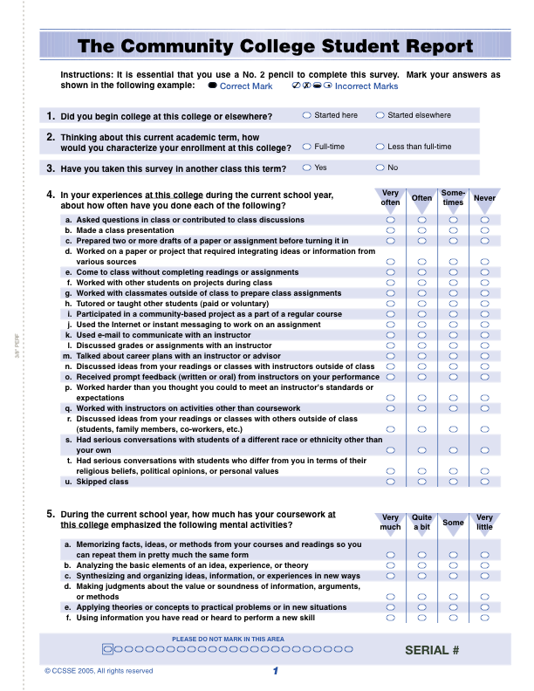
The Community College Survey of Student Engagement (CCSSE)
CCSSE is designed to capture student engagement as a measure of institutional quality.
Notes:
The Community College Survey of Student Engagement (CCSSE) is produced by the Center for Community College Student Engagement at the University of Texas at Austin, and it is designed to capture student engagement as a measure of institutional quality.

Slide 5
What is Student Engagement?
…the amount of time and energy students invest in meaningful educational practices
…the institutional practices and student behaviors that are highly correlated with student learning and retention
Notes:
Student engagement is the time and energy students invest in meaningful educational practices. This includes institutional practices and student behaviors that are highly correlated with student learning and retention.

Slide 6
CCSSE: A Tool for Community Colleges
CCSSE helps us
Assess quality in community college education
Identify and learn from good educational practice
Identify areas in which we can improve
Basic principles
Provides reliable data on issues that matter
Reports data publicly
Is committed to using data for improvement
Notes:
Like other community colleges, OSUIT is working to help students achieve their academic goals. CCSSE is a tool that helps us identify areas where we can improve programs and services for students. The basic principles driving the CCSSE focus on three things: relevant and reliable data; public reporting and accountability; and, continuous improvement.
The 2015 CCSSE Cohort for benchmarking comparisons represents over 442,000 community college students from 704 community and technical colleges in 47 states and the District of Columbia, three Canadian provinces, plus Micronesia and the Marshall Islands.

Slide 7
Student Respondent Profile at OSUIT

Slide 8
Survey Respondents
561 adjusted survey count
94% overall “percent of target” rate
Source: 2015 CCSSE data
Notes:
The survey was administered during class sessions. These classes were selected at random from all credit classes with the exception of labs, internships, dual-enrollment, distance learning, individual study, and self-paced classes.
Of those students sampled here at OSUIT, 561 respondents submitted usable surveys out of 621 total responses. With a target of 600, the number of completed surveys produced an overall “percent of target” rate of 94%.

Slide 9
Student Respondent Profile: Enrollment Status
Source: 2015 CCSSE data
Notes:
Enrollment Status
Population* data for all students at our college based on IPEDS is 39% part-time and 61% full-time.
Because of the sampling and administration process set up by CCSSE, a much higher proportion of our full time students participated. Survey results were either weighted or disaggregated so reports would accurately reflect the underlying student population*.
Stop narrative -----------------------------------------------------------------------------------------
*Population data are those reported for the most recent IPEDS enrollment report.

Slide 10
Student Respondent Profile: Educational Attainment
Source: 2015 CCSSE data
Notes:
Educational Attainment
67% started their college careers at OSUIT.
64% indicated that their highest level of educational attainment is a high school diploma or GED,
60% had completed fewer than 30 credit hours of college-level work,
24% reported having either a certificate or an associate degree,
4% have earned a bachelor’s degree, and
none (0%) have earned an advanced degree.

Slide 11
Student Respondent Profile: Goals
Source: 2015 CCSSE data
Notes:
Goals
Students were asked to indicate their reasons or goals for attending this college; note that students could choose more than one primary and secondary goal.
66% of our student respondents indicated that completing a certificate program is a primary or secondary goal.
For 88%, earning an associate degree is a goal.
For 53%, transferring to a 4-year institution is a goal.
For 87%, obtaining or updating job-related skills is a goal.
For 80%, self-improvement/personal enjoyment is also a goal.
And, 39% indicated career change as a goal.

Slide 12
CCSSE Benchmarks
Notes:
Now, for the benchmarks.

Slide 13
CCSSE Benchmarks for Effective Educational Practice
The five CCSSE benchmarks are
Active and Collaborative Learning
Student Effort
Academic Challenge
Student-Faculty Interaction
Support for Learners
Notes:
Benchmarks are groups of conceptually related items that address key areas of student engagement. CCSSE’s five benchmarks are areas that research has shown to be important in quality educational practice and can help us recognize where are we now, compared with where we want to be. These benchmarks are:
active and collaborative learning,
student effort,
academic challenge,
student-faculty interaction, and
support for learners.
Stop narrative ****************************
If the question comes up: Benchmark scores are standardized so the mean is 50 and the standard deviation is 25 (SD of 25 ensures that over 95% of scores fall between zero and 100).

Slide 14
Active and Collaborative Learning
Source: 2015 CCSSE data
Notes:
Students learn more when they can actively apply what they’re learning in various settings, starting with class participation: asking questions, engaging in discussion, and making presentations.
Through collaboration with others, students develop valuable skills that prepare them to deal with the kinds of situations and problems they will encounter in the real world.
Stop narrative *******************************************************************
The following seven survey items contribute to this benchmark:
During the current school year, how often have you:
Asked questions in class or contributed to class discussions (#4a)
Made a class presentation (#4b)
Worked with other students on projects during class (#4f)
Worked with classmates outside of class to prepare class assignments (#4g)
Tutored or taught other students (paid or voluntary) (#4h)
Participated in a community-based project as a part of a regular course (#4i)
Discussed ideas from your readings or classes with others outside of class (students, family members, co-workers, etc.) (#4r)

Slide 15
Active and Collaborative Learning
Source: 2015 CCSSE data
Notes:
Tutoring classmates or engaging in community-based projects as part of their coursework is less common, though about a third of the students reported doing so at times. Students are discussing ideas from class with others outside of the classroom, and that can help them integrate what they’ve learned.
Stop narrative *******************************************************************
The following seven survey items contribute to this benchmark:
During the current school year, how often have you:
Asked questions in class or contributed to class discussions (#4a)
Made a class presentation (#4b)
Worked with other students on projects during class (#4f)
Worked with classmates outside of class to prepare class assignments (#4g)
Tutored or taught other students (paid or voluntary) (#4h)
Participated in a community-based project as a part of a regular course (#4i)
Discussed ideas from your readings or classes with others outside of class (students, family members, co-workers, etc.) (#4r)

Slide 16
Student Effort
Source: 2015 CCSSE data
Notes:
There are a number of ways students can apply themselves to the learning process. For example, “Time on task” is a key variable. So, we asked how much time students spend preparing for class. About 15 students admitted to never preparing for class. 43% spend between 1-5 hours per week on study, homework, and the like.
Stop narrative ****************************************************
Eight survey items indicate how frequently students engage in a number of activities important to their learning and success are associated with this benchmark. They are: During the current school year, how often have you:
Prepared two or more drafts of a paper or assignment before turning it in (#4c)
Worked on a paper or project that required integrating ideas or information from various sources (#4d)
Come to class without completing readings or assignments (#4e)
Used peer or other tutoring services (#13d)
Used skill labs (#13e)
Used a computer lab (#13h)
During the current school year:
How many books did you read on your own (not assigned) for personal enjoyment or academic enrichment (#6b)
How many hours did you spend in a typical week preparing for class (studying, reading, writing, rehearsing, or other activities related to your program) (#10a)

Slide 17
Student Effort
Source: 2015 CCSSE data
Notes:
We asked how often the students worked on projects (60% often or very often).
Conversely, we asked how often they came to class without doing their readings or assignments (12% often or very often).
Stop narrative ********************************************
Eight survey items indicate how frequently students engage in a number of activities important to their learning and success are associated with this benchmark. They are: During the current school year, how often have you:
Prepared two or more drafts of a paper or assignment before turning it in (#4c)
Worked on a paper or project that required integrating ideas or information from various sources (#4d)
Come to class without completing readings or assignments (#4e)
Used peer or other tutoring services (#13d)
Used skill labs (#13e)
Used a computer lab (#13h)
During the current school year:
How many books did you read on your own (not assigned) for personal enjoyment or academic enrichment (#6b)
How many hours did you spend in a typical week preparing for class (studying, reading, writing, rehearsing, or other activities related to your program) (#10a)

Slide 18
Academic Challenge
Source: 2015 CCSSE data
Notes:
Challenging intellectual and creative work is central to student learning and collegiate quality.
Students report learning more when they are challenged to apply what they’ve learned in class to new situations.
We asked how challenging the exams were in their classes. From “Extremely easy” to “Extremely challenging’ on a 7-pt scale, most lean toward the upper half on the challenge scale.
Stop narrative *********************************************************************
Ten survey items address the nature and amount of assigned academic work, the complexity of cognitive tasks presented to students, and the standards faculty members use to evaluate student performance. They are:
During the current school year, how often have you:
Worked harder than you thought you could to meet an instructor’s standards or expectations (#4p)
How much does your coursework at this college emphasize:
Analyzing the basic elements of an idea, experience, or theory (#5b)
Synthesizing and organizing ideas, information, or experiences in new ways (#5c)
Making judgments about the value or soundness of information, arguments, or methods (#5d)
Applying theories or concepts to practical problems or in new situations (#5e)
Using information you have read or heard to perform a new skill (#5f)
During the current school year:
How many assigned textbooks, manuals, books, or book-length packs of course readings did you read (#6a)
How many papers or reports of any length did you write (#6c)
To what extent have your examinations challenged you to do your best work (#7)
How much does this college emphasize:
Encouraging you to spend significant amounts of time studying (#9a)

Slide 19
Academic Challenge
Notes:
We asked: How often did you work harder than you thought you could to meet an instructor’s standards or expectations? Most responded with “Sometimes” or “Often”.

Slide 20
Academic Challenge
Notes:
We asked students this question: “About how often have you done each of the following?” Here we have results for ANALYZING, SYNTHESIZING, MAKING JUDGMENTS, APPLYING CONCEPTS, and USING INFORMATION.

Slide 21
Student-Faculty Interaction
Source: 2015 CCSSE data
Notes:
In general, the more interaction students have with their instructors, the more likely they are to learn effectively and persist toward their goals. Personal interaction with faculty strengthens students’ connections to the college and helps them focus on their academic progress. Through student-faculty interaction, teachers become role models, mentors, and guides for continuous, life-long learning.
In the “How often do you do this?” category, emailing an instructor, receiving prompt feedback from an instructor, and discussing grades and assignments with an instructor occurred most often; deep philosophical discussions, not so much.
Stop narrative *******************************************************************************
The six survey items are associated with student-faculty interaction. They are: During the current school year, how often have you:
Used e-mail to communicate with an instructor (#4k)
Discussed grades or assignments with an instructor (#4l)
Talked about career plans with an instructor or advisor (#4m)
Discussed ideas from your readings or classes with instructors outside of class (#4n)
Received prompt feedback (written or oral) from instructors on your performance (#4o)
Worked with instructors on activities other than coursework (#4q)

Slide 22
Support for Learners
Source: 2015 CCSSE data
Notes:
Students perform better and are more satisfied at colleges that are committed to their success and cultivate positive working and social relationships among different groups on campus. They also benefit from academic counseling, career planning, and skill development services.
Stop narrative *****************************************************************
The seven survey items measuring support for learners are: How much does this college emphasize:
Providing the support you need to help you succeed at this college (#9b)
Encouraging contact among students from different economic, social, and racial or ethnic backgrounds (#9c)
Helping you cope with your nonacademic responsibilities (work, family, etc.) (#9d)
Providing the support you need to thrive socially (#9e)
Providing the financial support you need to afford your education (#9f)
During the current school year, how often have you:
Used academic advising/planning services (#13a)
Used career counseling services (#13b)

Slide 23
CCSSE Benchmarks for Effective Educational Practice
CCSSE Benchmark Scores for OSUIT
compared to 2015 CCSSE Cohort and 2015 Top-Performing Colleges
Source: 2015 CCSSE data
Notes:
We can use benchmarks to better understand our performance — and reach for excellence.
We can compare our performance to that of the national cohort, and top-performers in the cohort as we’ve done here;
We can seek areas for improvement at the item level as we’ve done in the preceding slides;
We can make sure all subgroups engage in their education at similarly high levels such as racial groups, part/full-time, etc.;
We can focus on areas that we value strongly, in light of our mission and goals.

Slide 24
Benchmarking – and Reaching for Excellence
The most important comparison:
where we are now, compared with
where we want to be.
Notes:
5. The most important comparison, though, is: where are we now, compared with where we want to be. This is the mark of an institution committed to continuous improvement.

Slide 25
Reaching for Excellence at OSUIT
More professional development in new and effective teaching strategies.
Feedback on academic performance— greatly affects retention
Build personal connections
Raise expectations and communicate them clearly and consistently
Notes:
Finally, here are some areas where we might reach for excellence, according to CCSSE:
To strive for more professional development in new and effective teaching strategies;
To provide feedback to students early-and-often… timely feedback can have a positive impact on retention;
To build personal connections with students on activities that involve coursework and those that extend beyond;
To raise expectations-push them and challenge them-communicate clearly and consistently what you expect out of your students.

Slide 26
Questions?
The report can be found on the OSUIT website under Institutional Research and Reports & Surveys:
osuit.edu/research/
Contact: Curtis Miller, Institutional Research Analyst
Michelle Canan, Director of Institutional Research
Notes:
The report can be found on the OSUIT website under Institutional Research:
osuit.edu/research/
Curtis Miller, Institutional Research Analyst
Michelle Canan, Director of Institutional Research

