Slide 1
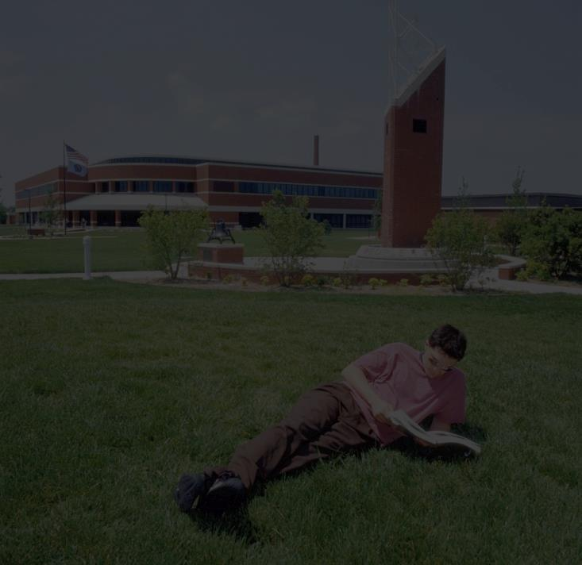
Welcome to Cowboy Up!

Slide 2
LASSO Center
and the
Office of Academic Accommodations

Slide 3
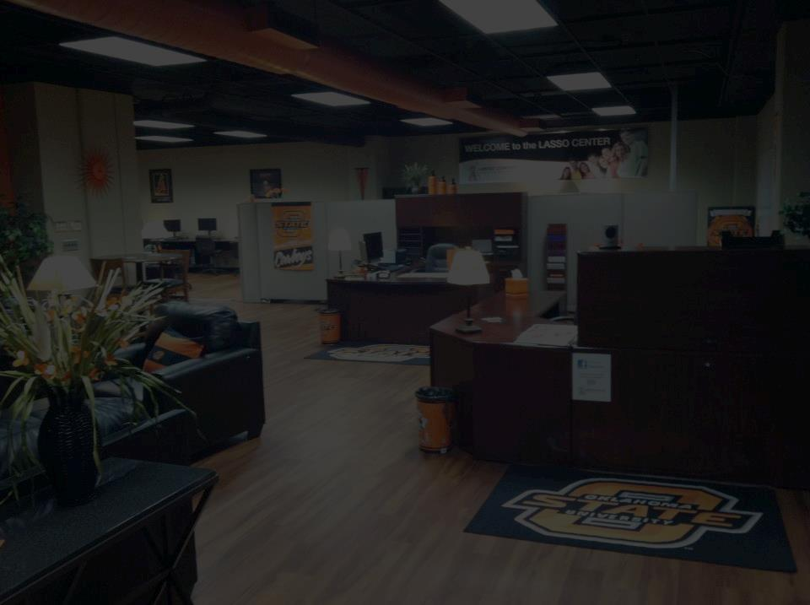
What does the word “LASSO” in “LASSO Center” mean?

Slide 4
“LASSO” means . . .
LASSO is an acronym for
Learning And Student Success Opportunity.
We want ALL students on campus to be SUCCESSFUL!
Notes:
asdfasdfasdfasdf

Slide 5
Our Purpose
The LASSO Center’s main purpose is to provide free tutoring for ALL students enrolled at OSUIT.
EVERY student is encouraged to take advantage of this free tutoring in all General Education classes, as well as many more specialized subjects.

Slide 6
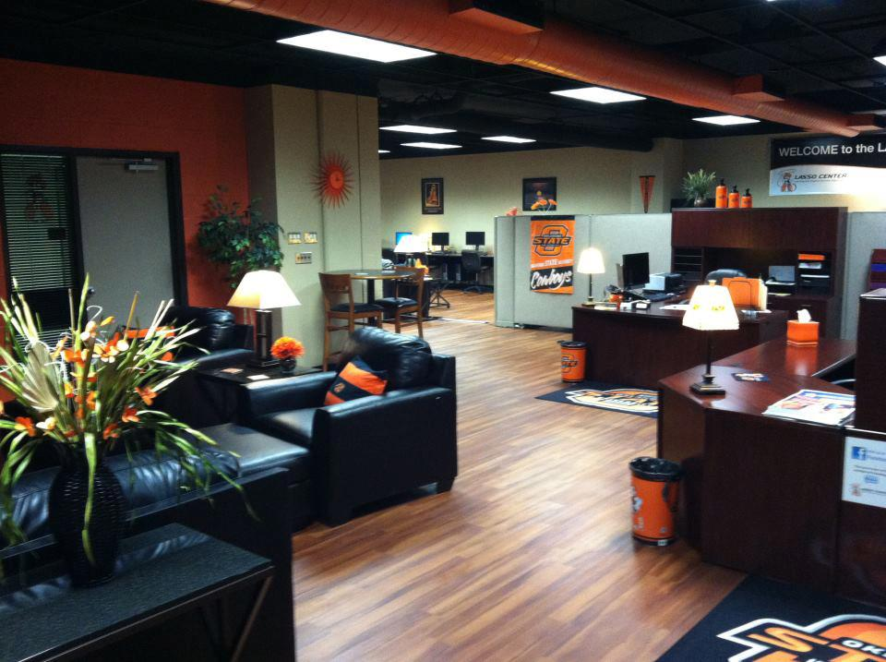
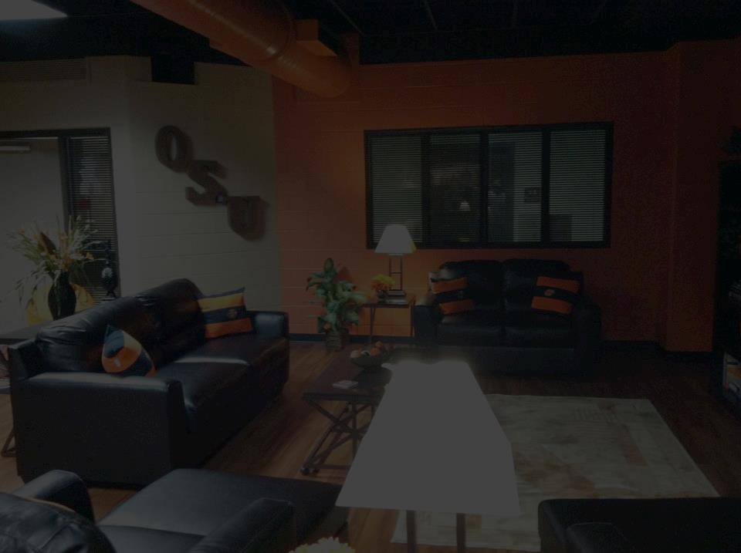
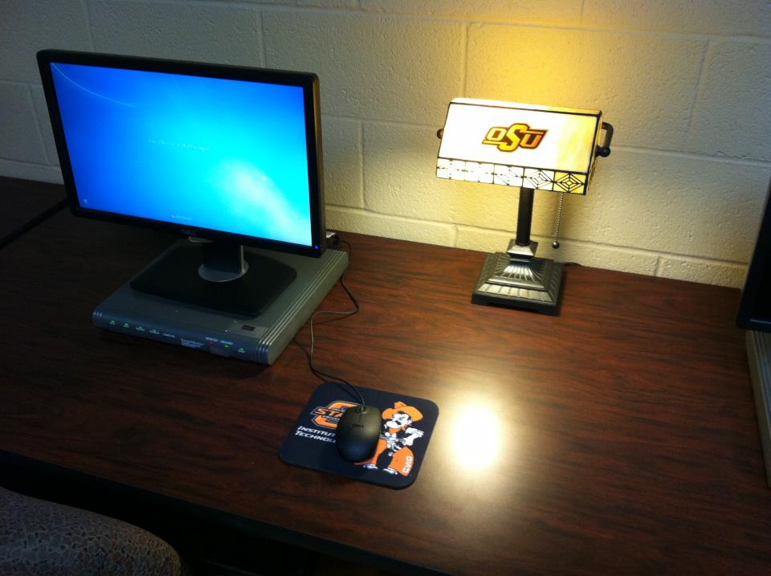
We also offer . . .
a convenient place to work on homework with tutors nearby
16 computers, a printer, and a laminator
TV and comfy couches
free popcorn
Pete’s Pantry
useful equipment to check out

Slide 7
Equipment to Check Out
iPads
Apple pencils
Livescribe smartpens
with notebooks
Easy reader strips
Webcam
Portable amplifiers

Slide 8
Proctored Exams
The LASSO Center also provides a convenient way for students to take proctored exams. We have a separate classroom for this purpose.
Arrive before 2:30 pm and bring your Student ID.

Slide 9
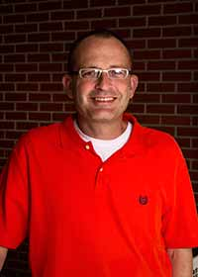
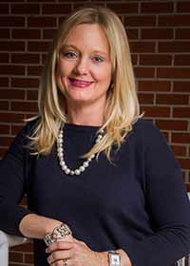
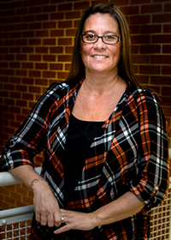
Our Office
Chad Spurlock
Director of LASSO Center and the Office of Academic Accommodations
Rae Ann Warner
Administrative Assistant;
Interpreter
Beth Rogers
Deaf Interpreter;
Adjunct Faculty

Slide 10
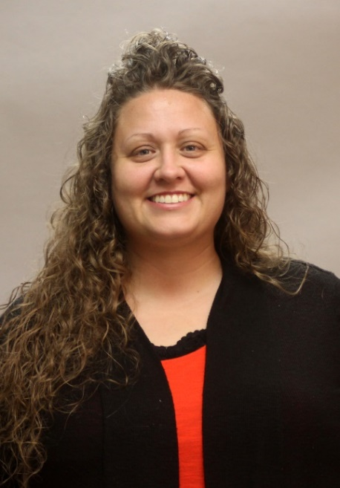
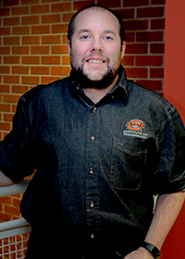
Tutors
Angie Been
English and Communications Tutor
Matthew Williams
Mathematics and Science Tutor
We also employ student tutors through the Federal and Institutional Work Study programs.

Slide 11
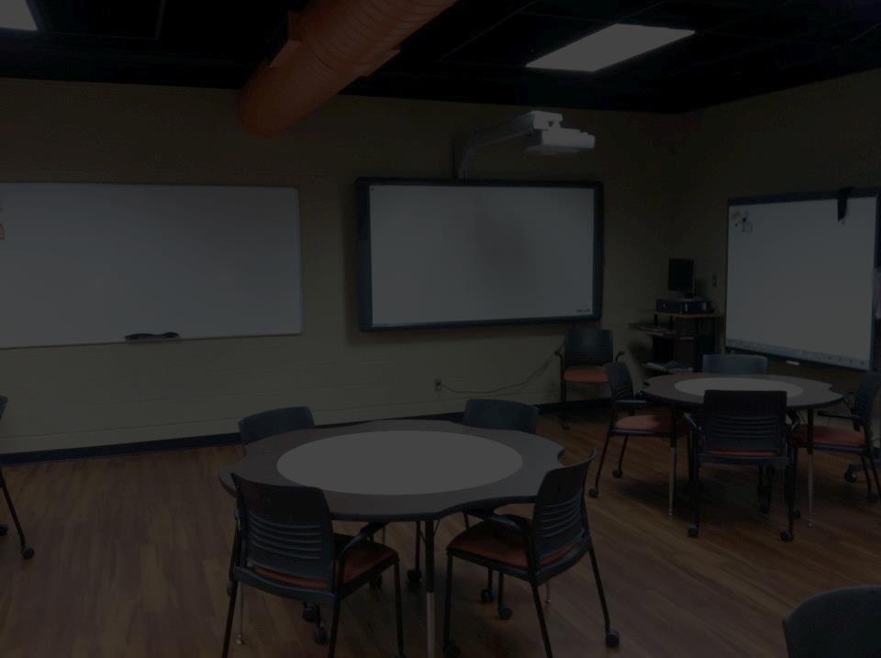
Contact Us
918-293-4855
rae_ann.warner@okstate.edu

Slide 12
LOCATION
Both the LASSO Center and the Office of Academic Accommodations are located in:
Room 308
Noble Center for Advancing Technology (NCAT), directly across from the elevator

Slide 13
Academic Accommodations
The Office of Academic Accommodations (Student Disability Services) is located within the LASSO Center. Academic accommodations are based on an individual’s specific needs and are designed to remove educational barriers.

Slide 14
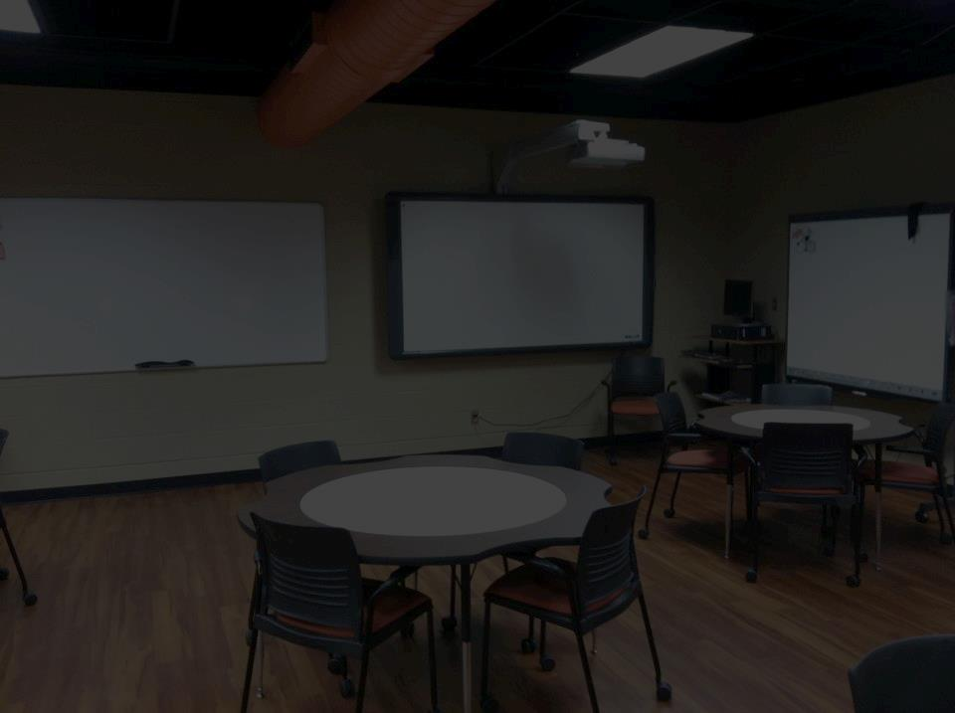
Obtaining Accommodations
Complete a “Request for Academic Accommodations” form, indicating the specific services you need.
Submit documentation that supports your need for accommodations.

Slide 15
Obtaining Accommodations
Accommodation requests are subject to approval by the Director of the Office of Academic Accommodations, Chad Spurlock.

Slide 16
Obtaining Accommodations
Upon approval, a letter listing your specific accommodations will be created. You then will deliver a copy of this letter to your instructors.

Slide 17
Obtaining Accommodations
You must update and sign the Request for Academic Accommodations form each semester in order to continue receiving academic accommodations.

Slide 18
Our Hours
Both the LASSO Center and the Office of Academic Accommodations are open from 8:00 am - 4:30 pm
Monday through Friday
No appointment is necessary

Slide 19
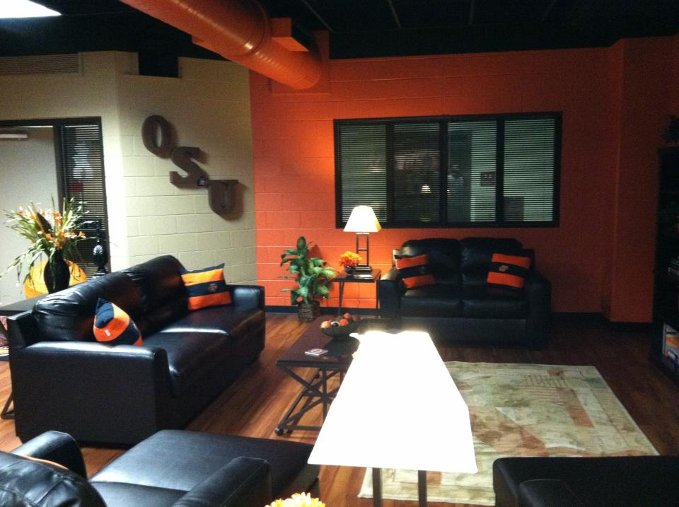
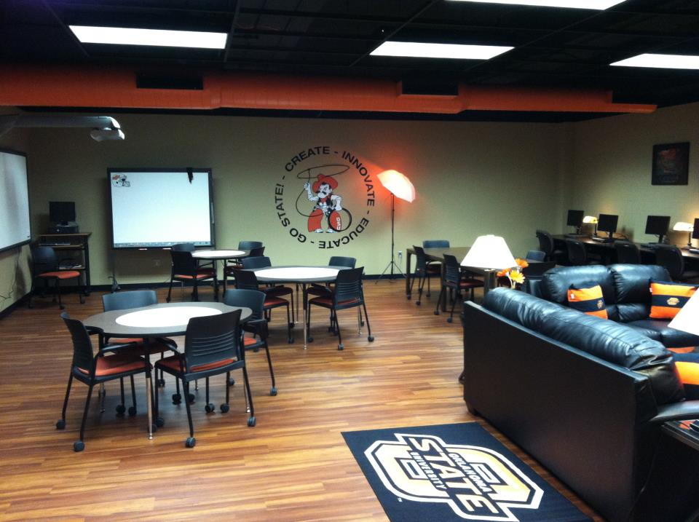
Questions?
We look forward to seeing you!

