Slide 1
Student Union & Auxiliary Services
Cowboy Up!
Welcome to OSUIT

Slide 2
Student Union & Auxiliary Services
Bookstore
Convenience Store
Child Care Center
Campus Health Services
Vending Services
Post Office
Cowboy Cafe/Dining Services

Slide 3

Bookstore
Open Monday – Friday 7:30am to 4:30pm
Student Bursar’s Account Charges
Book Reservation Program
Book Rental Programs
On-line Bookstore
Book Buy Back

Slide 4

University Market C-Store
Open Monday – Friday 7:00am to 10:00pm
Open Sat. & Sun 2:30pm to 10:00pm
Freshly Made
  Salads
  Sandwiches
  Wraps
  Pizza

Slide 5
Child Care Center
Open Monday – Friday 7:00am to 5:00pm
Accepts Children Ages 6 Weeks to 13 Years
Participates in State Food Program
Weekly Rates for Full Time and Part Time Children
Before and After School Service Available
Drop in Child Care Rates (only when space is available)

Slide 6
Campus Health Services
Open Monday – Friday 11:30am to 1:00pm
OSUIT Contracts Local Physicians
Individual Responsible for Additional Cost
Student Health Insurance

Slide 7

Vending Services
Operates over 50 Soft Drink, Snack and Juice Machines in a Variety of Locations on Campus

Slide 8
Post Office
Open Monday – Friday 9:30am to 4:15pm
(exceptions include university or U.S. holidays)
PO Box Rent $1 Per Semester
Residence Hall Students Receive Mall in Residence Hall

Slide 9
Cowboy Café/Dining Services
Hours of Operation
  Breakfast
    (M-F) 6:30am to 9:30am
    (Saturday) 8:00am to 9:00am
  Lunch
    (Daily) 11:00am to 1:00pm
  Dinner
    (M-F) 4:30pm to 6:00pm
    (Weekends) 5:00pm to 6:00pm

Slide 10
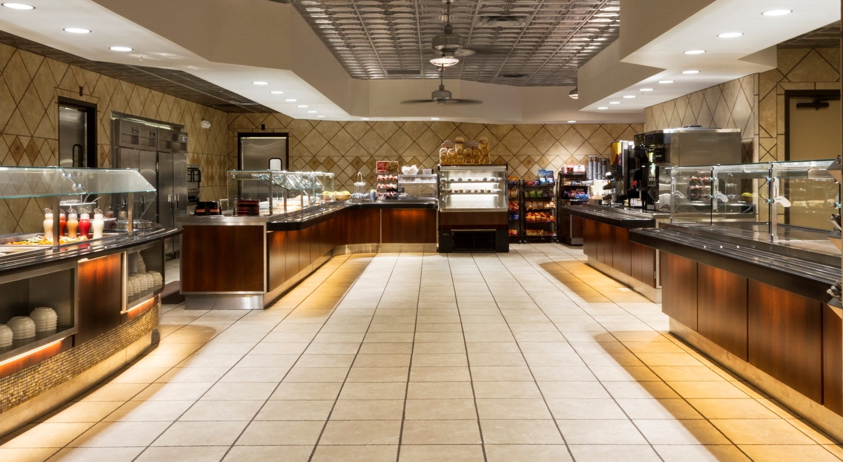
Cowboy Café/Dining Services
Remodeled 2014

Slide 11
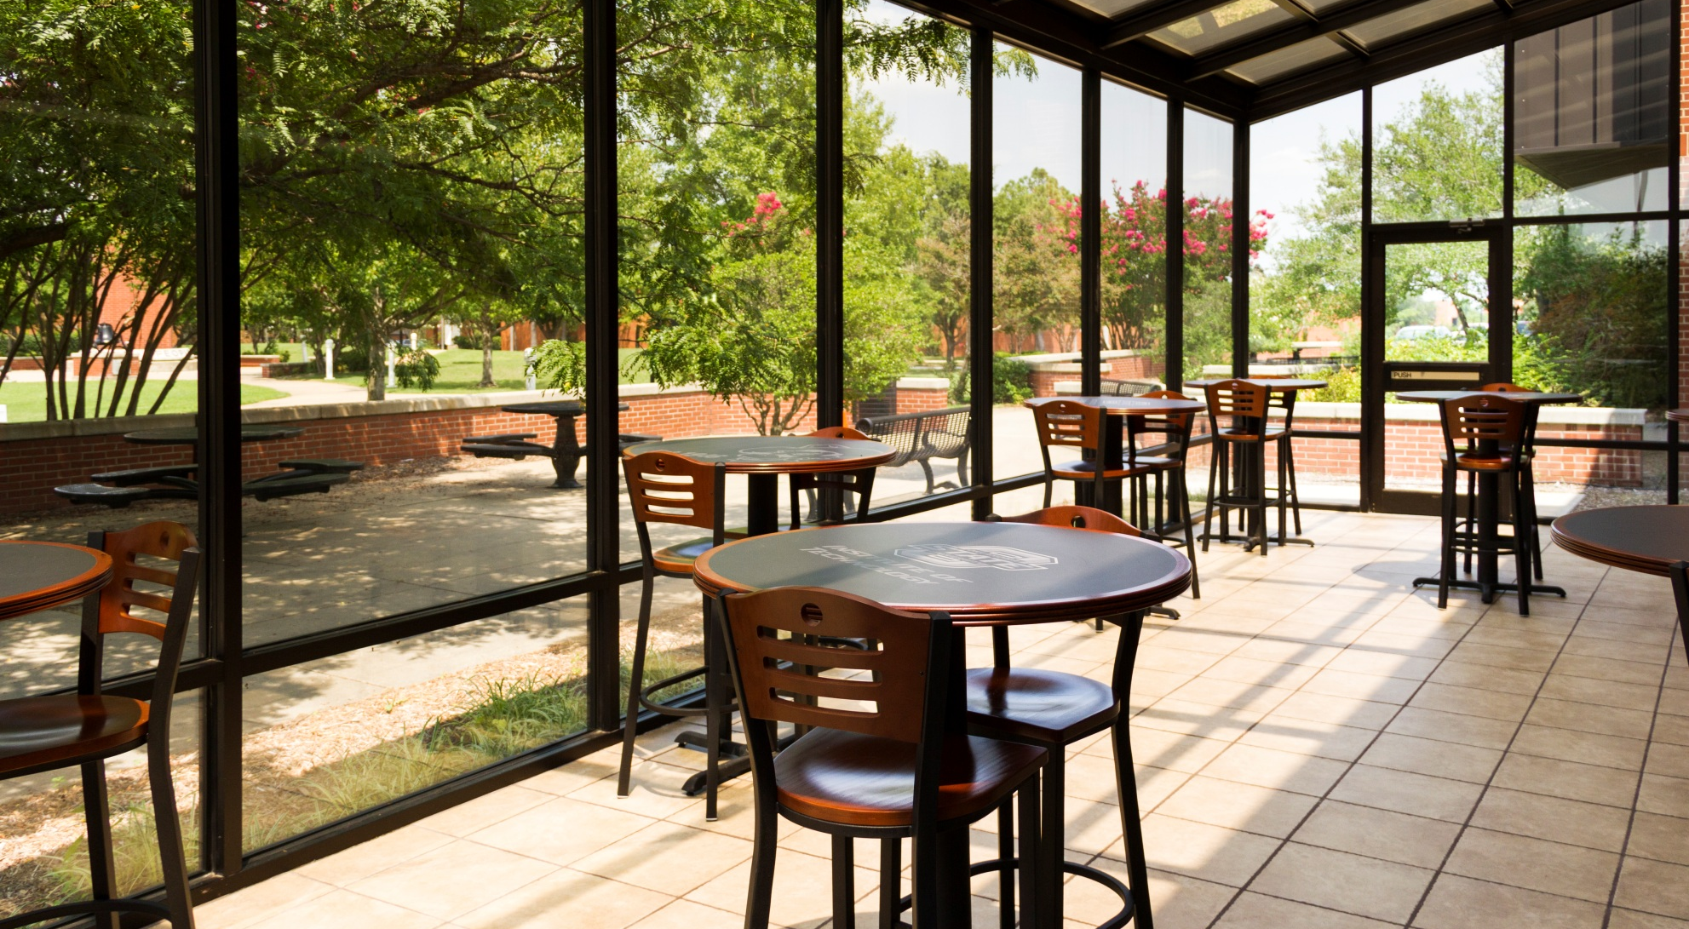
Cowboy Café/Dining Services
Remodeled 2014

Slide 12
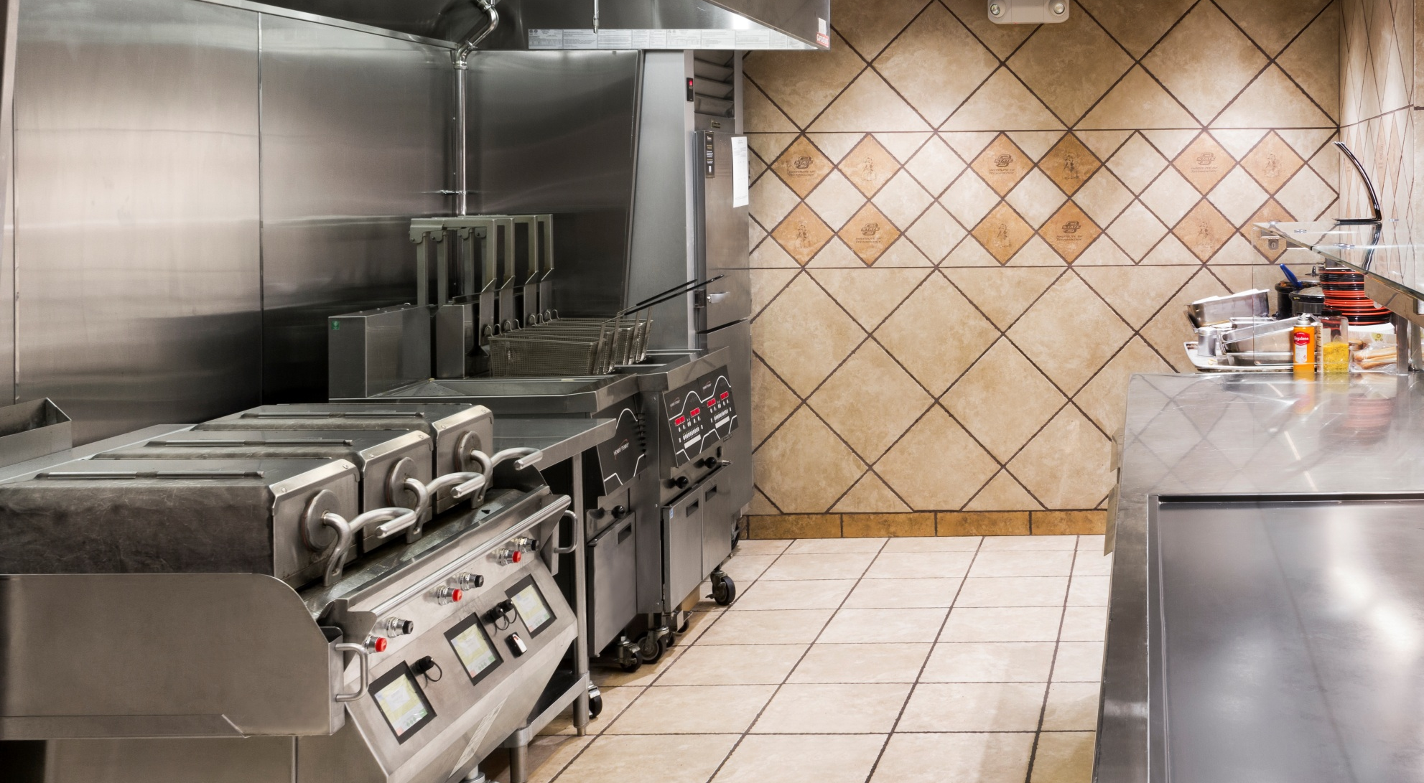
Cowboy Café/Dining Services
Remodeled 2014

Slide 13
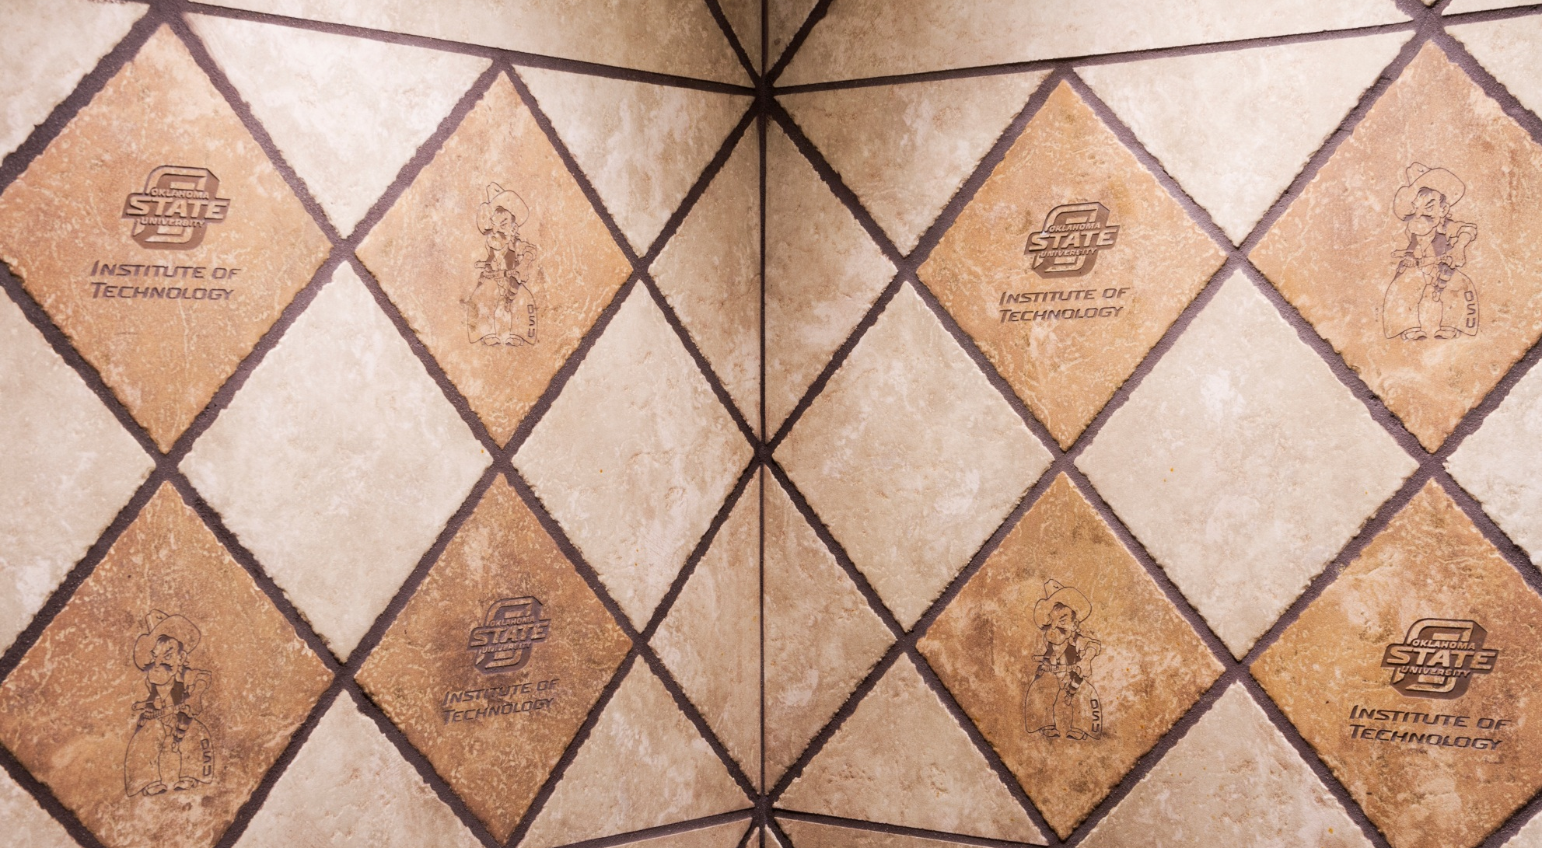
Cowboy Café/Dining Services
Remodeled 2014

Slide 14
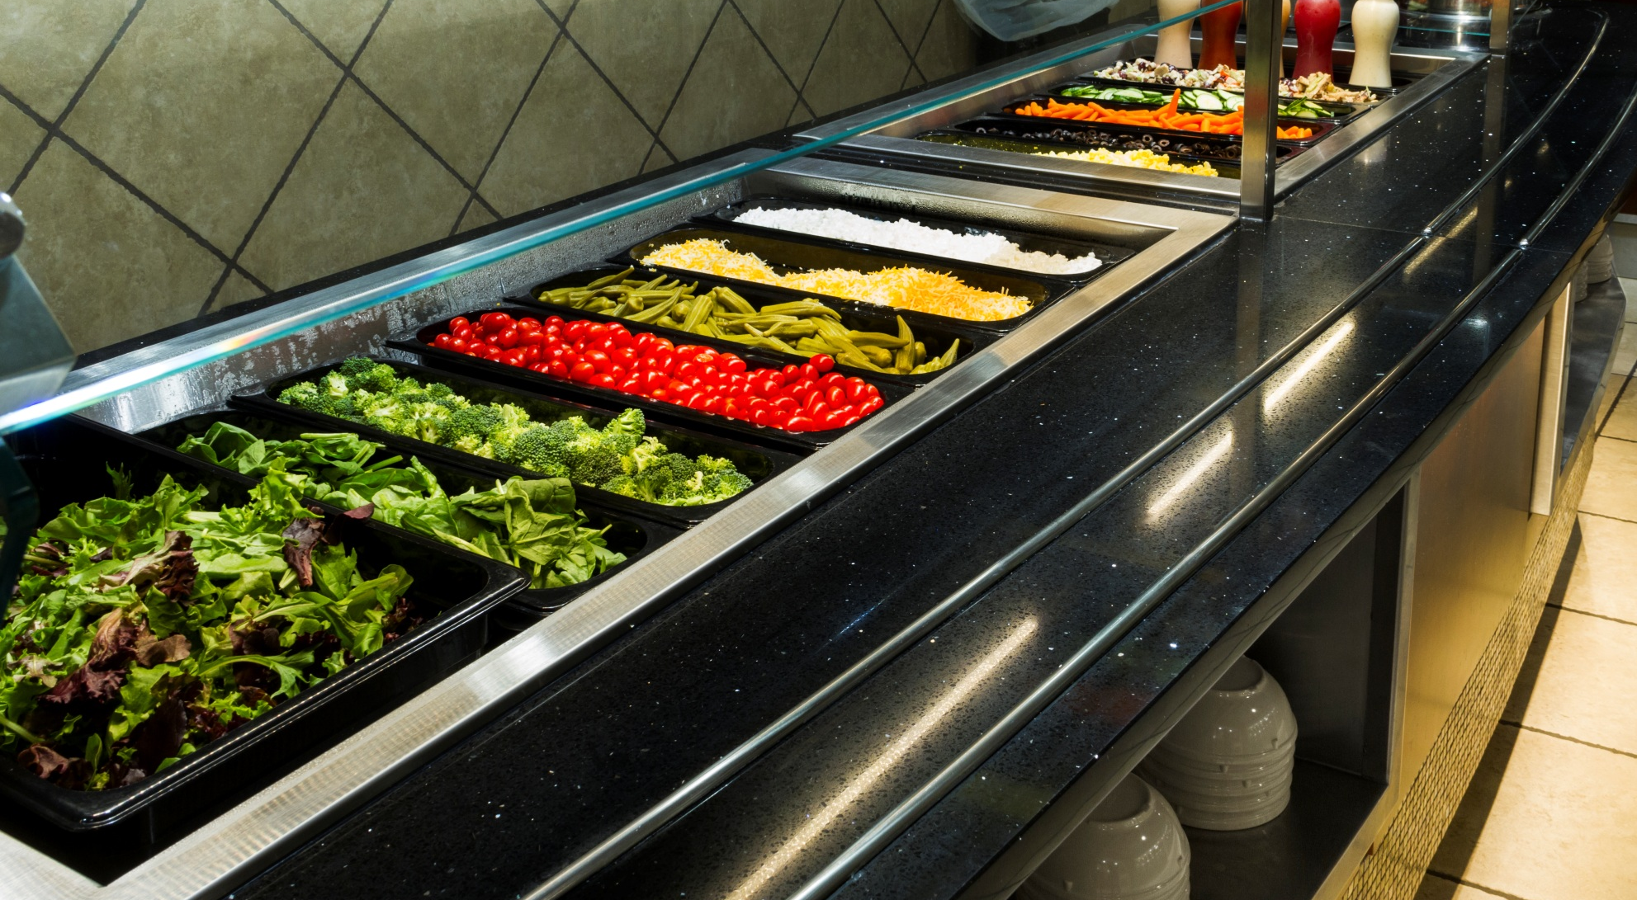
Cowboy Café/Dining Services
Remodeled 2014

Slide 15
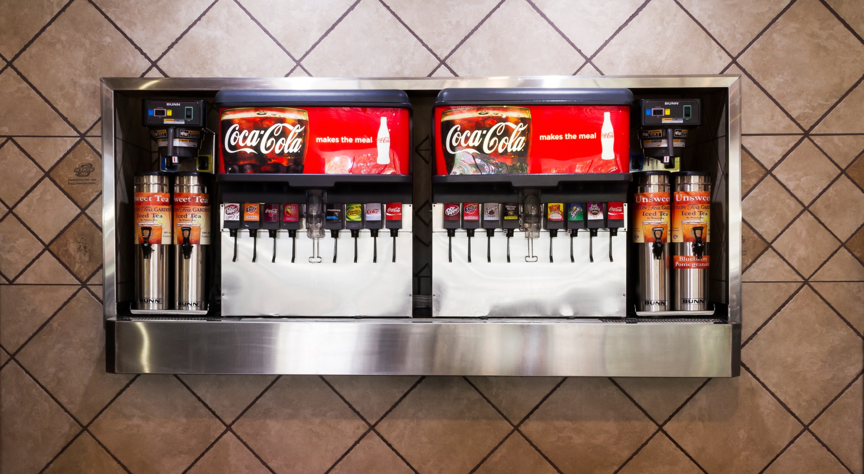
Cowboy Café/Dining Services
Remodeled 2014

Slide 16
Student Union Building
OSUIT Credit Union
Cowboy Café/Dining Services
Student Lounges
  Viersen Lounge
  ONG Lounge
  PSO Lounge
(4) Meeting/Dining Rooms
Veterans Lounge Area
Bookstore
Post Office
Conoco Art Gallery
Campus Health Services
Student Union Services Office Open (M-F) 7:30am to 4:30pm

