Slide 1
Welcome!

Slide 2
Campus Safety

Slide 3
Campus Safety

Slide 4
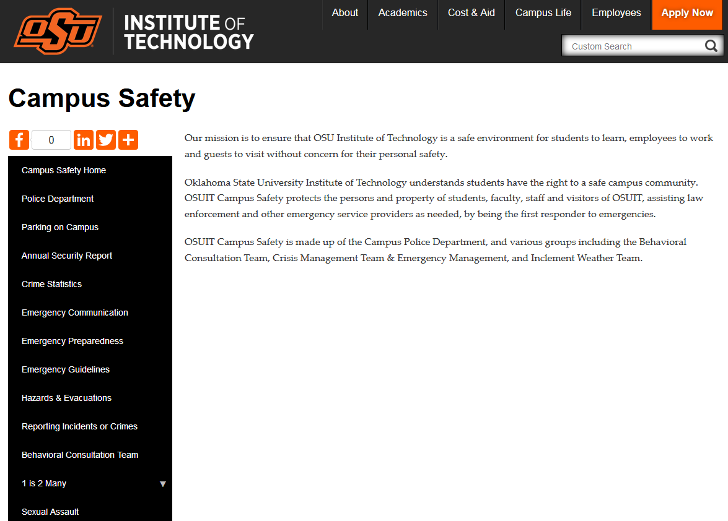
How Do I
Tell Someone?...

Slide 5
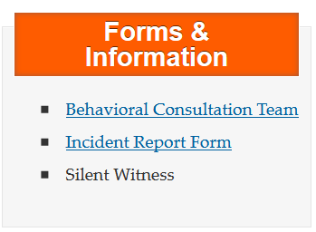
The BCT is a specially trained group with mental health, student development, law enforcement, academic, administrative, and legal expertise. The Team investigates and evaluates questionable behavior and threats. The Team’s goal is to work with all parties involved to advocate for a safe campus environment.
The Incident Report Form is one form for all!
Residence Life reports for concerns or actions that are in Dorms.
General Incident report for concerns or actions that present a danger to an individual or the OSUIT community
Academic Integrity report for incidents involving violations of the OSU IT Academic Integrity policy.
Concerning or Threatening Behavior for concerns or actions that pose a risk for harm or danger to self or others.
FYI for concerns that are worrisome but do not present an immediate danger to self or others.

Slide 6
OSUIT takes acts of
sexual violence and harassment seriously…
Victim Advocates
Survivor Support and Counseling
Certified Title IX Sexual Assault Investigators
Prevention Training
Everyone Deservers Kindness, Dignity and Respect!
You are not alone!

Slide 7
How Will You Know There is an
Emergency?
Depending on the nature of the emergency, OSUIT may use all or some of the following when activating the Emergency Notification System called
OSUIT COWBOY ALERT
Cowboy Alert:
Text & Voice Alerts
Facebook & Twitter
Webfreeze
University Group Email
Local Media
Weather Radios
Patrol Car Announcements
OSUIT Webpage
Types of Alert Messages:
General Safety Information
School Closing
Shelter in Place
Lock Down
ALL CLEAR

Slide 8
Sign Me Up!
To subscribe, go to: https://app.it.okstate.edu/okey/ and log into your O-Key account. From there you may navigate to the left of the nav. bar and select “Emergency Contacts.” If you have any questions, please contact the IT help desk. Be sure to update your information with any changes.

Slide 9
What Else Should I Know?
To help ensure that students can exercise their rights as individuals while at the same time ensuring that the rights of those around them are upheld, certain basic policies have been established to facilitate mutual respect and consideration among students.
You Should Know These!

Slide 10
Where Do I Find Them?

Slide 12
Important Phone Numbers
Counseling Services
918-293-4988
University Health Services
918-293-5292
Muscogee Creek Nation Medical Center (Hospital)
918-756-4233
Poison Control
800-222-1222
Emergencies on Campus
918-293-5000 & 911
Questions? Call Campus Operator 918-293-4678
Or “0”
OSUIT Police Dispatch
918-293-5000
Residential Life
918-293-4928

Slide 13
OSUIT
POLICE
918-293-5000

Slide 14
WELCOME
FIRST and FOREMOST We are here to serve you!
Campus police is located at the North end of the Workforce Oklahoma building.
Only OSUIT Dept. that is staffed and operated 24/7/365.

Slide 15
Things to Remember
OSUIT is a Dry Campus: No Alcohol
OSUIT has policies against illegal Drugs
Minors not allowed on campus without parent or guardian. Pets/animals NOT allowed on campus either (Does not include service animals)
Do not loiter or hang out in parking lots
Keep your OSUIT/State I.D. on you at all times

Slide 16
Things to Remember (Cont.)
2 week buffer at the start of the spring and fall trimesters on parking enforcement ONLY.
As students you may NOT use “visitor” parking.
Sign up online for your Parking Permit at:
https://osuit.edu/parking-permit

Slide 17
Things to Remember (CONT.)
If you bring a towable item to campus (Boat, trailer with ATV, etc.) you cannot park it in a residential lot.
Do not attach or chain towable items to University property.
Contact campus police and give them your contact information/description if bringing towable item to campus.

Slide 18
Examples of how NOT to PARK

Slide 19
DON’T BE THIS PERSON

Slide 20
OR THIS PERSON

Slide 21
OR THIS PERSON

Slide 22
OR THIS PERSON

Slide 23
CAN ANYONE GUESS THE #1 CRIME AT OSUIT???
HINT: Happens every trimester.
Very few people report this crime.
We at OSUIT enjoy a relatively low crime rate for our population size and geographical area.

Slide 24
LARCENY/THEFT

Slide 25
Things to Remember (CONT.)
Keep personal items and valuables locked up at all times.
Especially vehicles and dorm rooms.
Writer down serial numbers or engrave information on high value items.

Slide 26
Things to Remember
Annual Security Report: Available On-Line
CLERY Act Annual Campus Crime Statistics
Familiarize yourselves with the campus parking and traffic policies on the web at:
https://osuit.edu/safety/parking.php

Slide 27
Questions?

